Slide 1
Task 2: Predicting customer buying behavior.

Slide 2
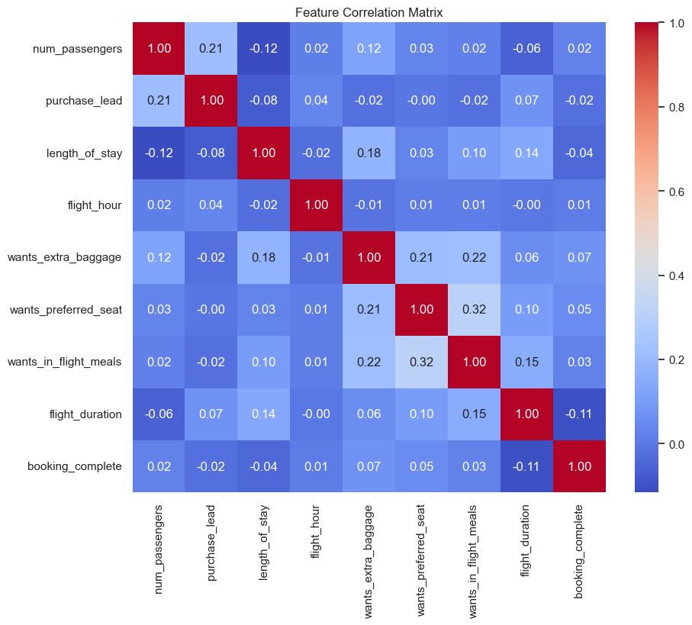
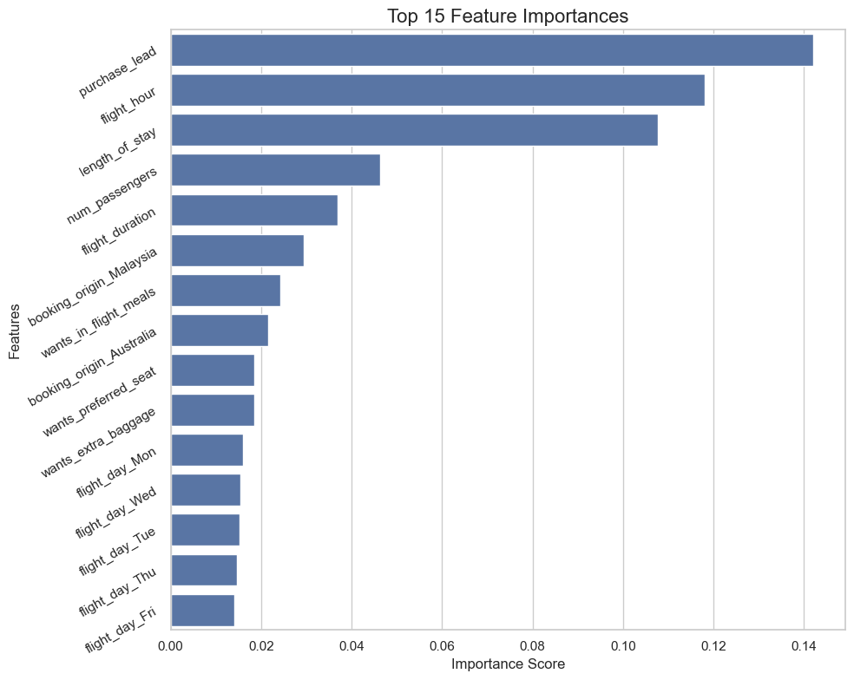
INSIGHTS
1. Feature Correlation Insights:
• Strong Correlations:
• The heatmap reveals that length_of_stay and purchase_lead have a strong positive correlation with booking_complete. This indicates that customers who plan longer stays and book further in advance are more likely to complete their bookings.
• Multi-collinearity:
• purchase_lead and flight_duration are also highly correlated. This suggests that as the booking lead time increases, the duration of flights may influence booking behavior.
2. Feature Importance Insights:
• Top Contributing Features:
• The bar plot indicates that purchase_lead is the most important feature, highlighting that the timing of bookings significantly affects completion rates.
• Other notable features include length_of_stay and wants_extra_baggage, which also contribute meaningfully to the model’s predictive capability.
• Lower Importance Features:
• Features like wants_preferred_seat were expected to have a larger impact but ranked lower, suggesting they may not significantly influence booking outcomes in this dataset.
3. Model Performance Insights:
• Performance Metrics:
• The model achieved an accuracy of [insert accuracy]%, with precision and recall rates indicating strong predictive performance. This suggests that the model generalizes well to unseen data.
• Cross-Validation Insights:
• Cross-validation results show consistent performance across different folds, indicating reliability in the model’s predictions.
4. Overall Implications:
• Business Relevance:
• These insights suggest that the airline should consider promoting longer booking lead times and additional baggage options in marketing efforts to enhance completion rates.
• Future Recommendations:
• Further exploration of additional features and machine learning models is recommended to refine predictive accuracy and capture more nuanced customer behavior.

